Slide 1

Wireless and Mobile Communication UEC746

Slide 2
Diversity
A diversity scheme is a method that is used to develop information from several signals
transmitted over independent paths.
It is used to compensate for fading channel impairments and is usually implemented by using two or more receiving antennas.
Diversity exploits the random nature of radio propagation by finding independent
(uncorrelated) signal paths for communication.
Diversity is employed to reduce depth and duration of the fades experienced by the receiver in a flat fading (narrow band) channel.
No training and tracking is required.
Diversity provides significant link improvement with little added cost. Diversity decisions
are made by the receiver and are unknown to the transmitter.

Slide 3
If one radio path undergoes an deep fade another independent path may have strong signal and by having more than one path to select from, both instantaneous and average SNR, at the receiver may be improved often by as much as 20 dB to 30 dB.
General Types of Diversity
Microscopic Diversity
Macroscopic Diversity
Microscopic Diversity
Prevents small scale fading.
Small scale fading is caused by multiple reflections from the surroundings. It is characterized by deep and rapid amplitude fluctuation which occur as the mobile moves over distances of a few wavelengths.
This fading is prevented by selecting an antenna which gives a strong signal that mitigates
small scale fading.

Slide 4
Macroscopic Diversity
Prevents large scale fading.
Large scale fading is caused by shadowing due to variation in both the terrain profile and the nature of surroundings.
Large scale fading is normally distributed.
This fading is prevented by an antenna which is not shadowed when others are, this allows increase in SNR.
If there is a hill between the BS and the MS then simply increasing the Tx antenna and Rx
antenna doesn’t make any difference.
Thus an intermediate BS (BS2) is placed in between the BS and MS so that the hill does not
lie in between the BS and BS2.
Receive – Amplify – Re-transmit.

Slide 5
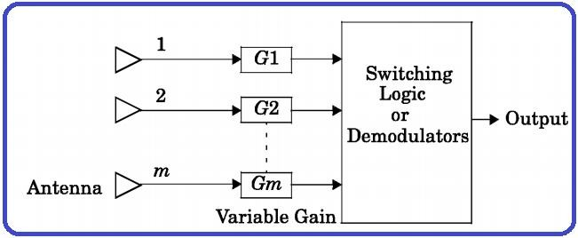
Commonly used Diversity Techniques
Space Diversity
Polarization Diversity
Frequency Diversity
Time Diversity
Angular diversity
Space Diversity
Also called Antenna-Diversity.
Signals received from spatially separated antennas on the mobile would have essentially uncorrelated envelopes for antenna separations of one-half wavelengths or more.
Block diagram of Space Diversity
“A method of transmission or reception or both, in which the effects of fading are minimized by the simultaneous use of two or more physically separated antennas, ideally separated by one half or more wavelength”.

Slide 6
Polarization Diversity
At the base station, space diversity is considerably less practical than the mobile because the narrow angle of incident field require large antenna spacing.
In such situation, polarization diversity is preferred.
Horizontal and vertical polarization or circular and linear polarization
uncorrelated signals at the receiver.
It does not require antenna spacing.
Dramatically reduce multipath delay spread.
Require antenna orientation to achieve orthogonal polarization to be used.
provides
Frequency Diversity
Transmit information on more than one carrier frequency.
Separation between the carriers should be at least the coherent bandwidth (BW = df = Bc).
Uncorrelated frequency suffer different level of fading in frequency selective channels i.e. different copies undergo independent fading.
Only one antenna is needed.

Slide 7
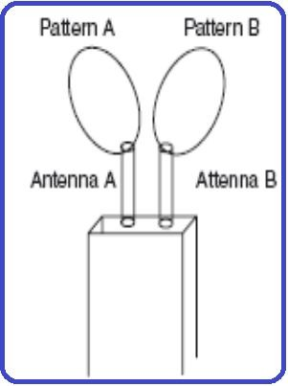
Time Diversity
Transmit the desired signal repeatedly in M-different periods of time (each symbols is transmitted M-times), which exceeds the coherence time of the channel.
The interval between transmission of same symbol should be at least the coherence time (dt = TC)
Different copies undergo independent fading. - Reduction in efficiency (effective data rate < real data rate).
RAKE receiver for spread spectrum CDMA is based on time diversity.
Angular Diversity
It enhances the decorrelation of signals at closely spaced antennas.
Different antenna patterns can be achieved very easily.
This effect is due to Mutual Coupling.

Slide 8
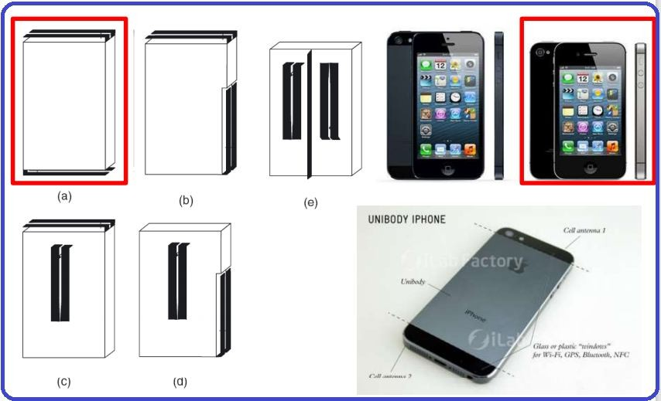
Mutual Coupling
Place two identical antennas close to each other.
Here antenna B acts as a reflector for antenna A.
Antenna A acts as a reflector for Antenna B.
Hence the pattern of both the antennas are skewed as shown in figure.
Of course Antennas with different radiation pattern
can also be used.
Mutual Coupling can also be increased by locating the antenna at different parts of the casing.
The various possibilities are shown in the figure.
Wireless & Mo
bile communication (UEC746) 9

Slide 9
Space Diversity Reception Methods
Selection Diversity
Feedback/Scanning Diversity
Maximal Ratio Combining
Equal Gain Combining
Selection Diversity
It offers an average improvements in the link margin without requiring additional transmitter power or sophisticated receiver circuitry.
There are two selection criteria:
RSSI – Received Signal Strength Indication
BER – Bit Error Rate
10

Slide 10
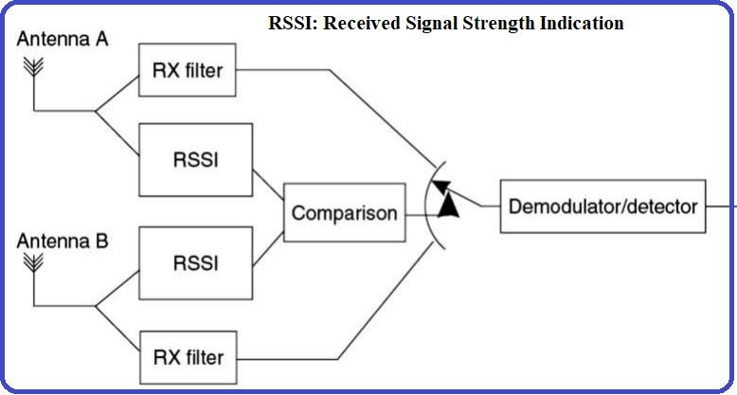
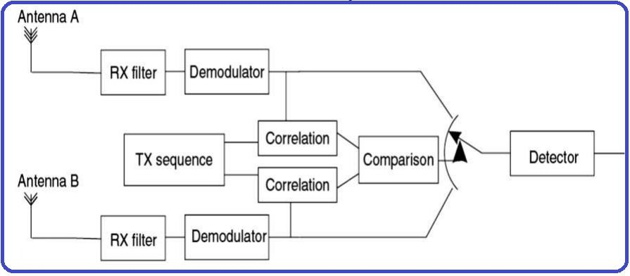
Continue…
RSSI – Driven Selection Diversity
The receiver selects the signal with the largest instantaneous power.
The receiver branches having the highest instantaneous SNR is connected to the demodulator.
BER – Driven Selection Diversity
We first transmit the Training Sequence. (ie) Know signal / sequence.
The Rx then demodulates the signal from each antenna and compares / correlates it with the transmit signal.
The antenna which received the smallest BER is
chosen as the best and that signal is processed
further.
11

Slide 11
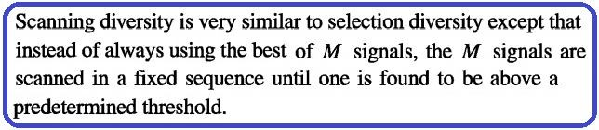
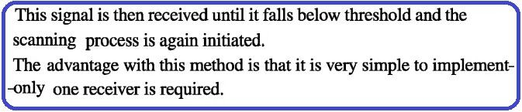
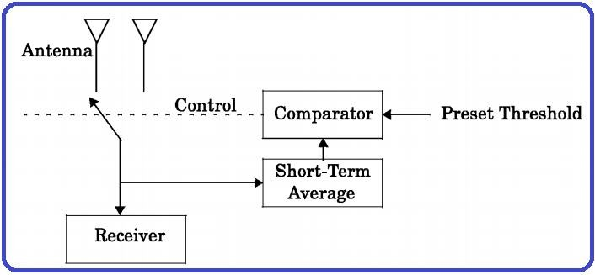
Feedback/Scanning Diversity
Scanning all the signals in a fixed sequence until one with SNR more than a predetermined threshold is identified.
Signal received continuously until it falls below threshold from the branch having signal above predetermined threshold.
Require only one receiver.
11/16/2020
12

Slide 12
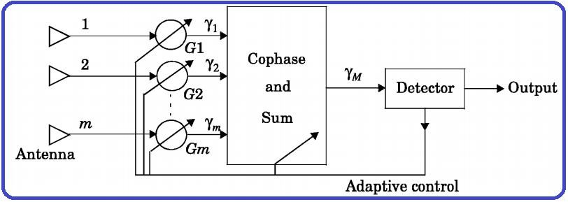
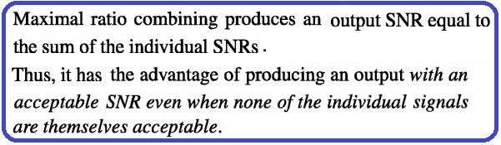
Maximal Ratio Combining
Signals from all of the M-branches are weighted according to the signal voltage to noise
power ratios and then summed.
Produces output – SNR equal to the sum of the individual SNRs.
Gives best statistical reduction of fading of any known linear diversity combiner
Signal copies are weighted and combined coherently:
MRC ∑ i i=1
L L
∑ i i=1
Z =
j − j
2
a e a e =
a
i
i
i
11/16/2020
Wireless & Mobile communication (UEC746)
13

Slide 13
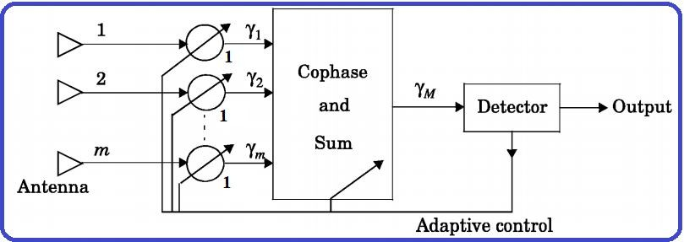
Equal Gain Combining
Instead of variable weighting, each branch weight is set to unity.
So combining all the signals in a co-phased manner with unity weights for all signal levels so as to have the highest achievable SNR at the receiver at all times.
The performance is marginally inferior to maximal ratio combining (MRC) and superior
to selection diversity.
Signal copies are combined coherently:
L
L
= a e e = ∑ a
Z
EGC ∑ i
j − j
i
i
i
i=1
i=1
13

Slide 14
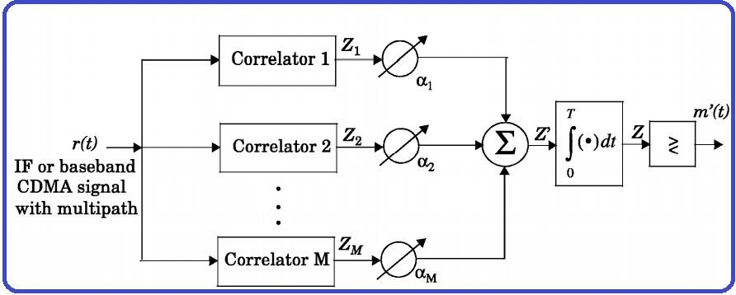
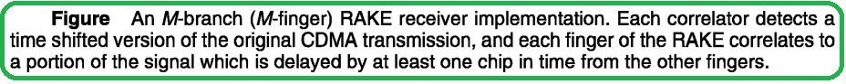
RAKE Receiver
Since, multipath components of the signal carry important information. They are time delayed versions of the original signal.
RAKE receiver collects the time shifted versions of the original signal by providing a separate correlation receiver for each of the multipath signals.
14

Slide 15
Continue…
A receiver technique which uses several baseband correlators to individually process several multipath components. The correlators outputs are combined to achieve improve communication reliability and performance.
RAKE receivers are mostly/widely used in CDMA, spread spectrum system. In CDMA, the chip-rate is typically much greater that the flat-fading bandwidth of channel. CDMA spreading codes are designed to provide very low correlation between successive chips and thus if the multipath versions of the transmitted signals are delayed in time by more than one chip duration, they appear like uncorrelated noise at receiver, an equalization is not required.
RAKE receiver in CDMA, combine delayed version of the signals to improve the received SNR –collect the time shifted version of the original signal by providing a separate correlation receiver for each signals.
15

Slide 16
Continue…
RAKE receiver uses multiple correlators to separately detect M strongest multipath components. The output of each correlators are then weighted to provide a better estimate of a transmitted signal than is provided by the signal component.
Demodulation and bit decisions are then based on the weighted outputs of the M – correlators.
Weighting coefficients are based on the power or the SNR from each correlators
output.
16

Slide 17

17

